Slide 1
Kafka
Chiayi Wu
2019/02/20

Slide 2
Outline
What is Kafka
Kafka Ecosystem
Kafka Core Concepts
Records
Topics, Partitions, Offsets
Brokers, Replicate
Producer
Consumer

Slide 3

Kafka
Apache Kafka is a distributed streaming platform.
Publish and subscribe to streams of records, similar to a message queue or enterprise messaging system.
Store streams of records in a fault-tolerant durable way.
Process streams of records as they occur.
0.9

Slide 4
Kafka Ecosystem
Source System
DB
Producer
SAP
Elasticsearch
Wistron
EAI
SFCS
Java Consumer
Kafka
Redis
LMS
Oracle
Logstash

Slide 5
Kafka Core Concepts
Producers publish records to brokers.
Consumer subscribe records from brokers.
Records
Key: Used by compaction or for message grouping
Ex: If messages were sent from the producer in a specific order, we set Kafka key for guarantee the order.
Value: The content of data

Slide 6
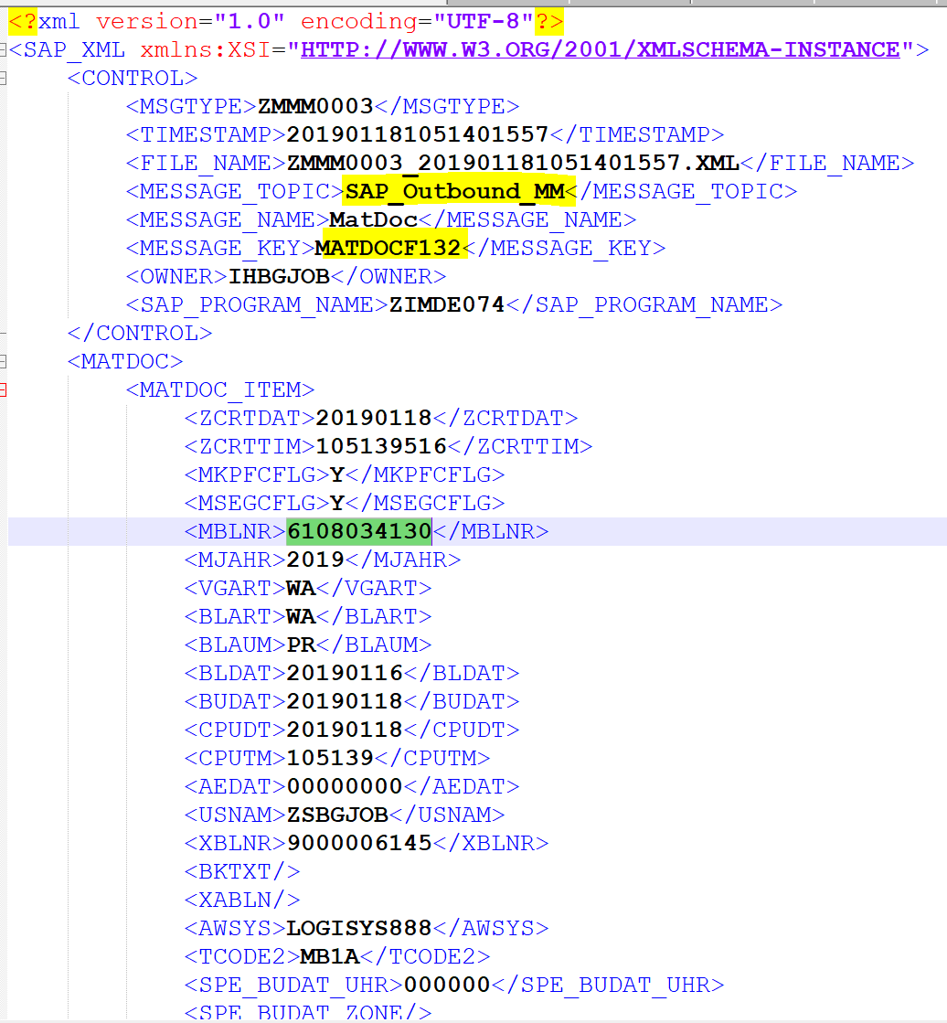
Kafka Core Concepts
Producers publish records to brokers.
Consumer subscribe records from brokers.
Records
Key: Used by compaction or for message grouping
Ex: If messages were sent from the producer in a specific order, we set Kafka key for guarantee the order.
Value: The content of data

Slide 7
Kafka Core Concepts
Record is stored in topics.
Topics are split in partitions. Each partition is an ordered, immutable sequence of records that is continually appended to—a structured commit log.
The records in the partitions are each assigned a sequential id number called the offset that uniquely identifies each record within the partition.
Notes:
定義

Slide 8
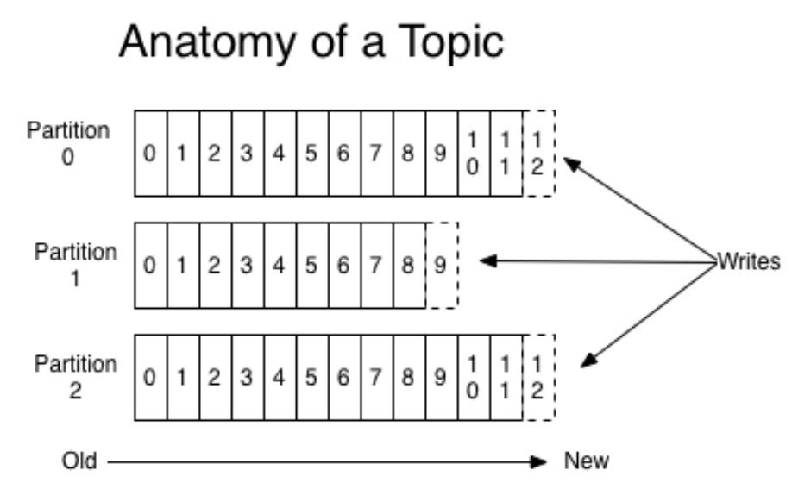
Kafka Core Concepts

Slide 9
Kafka Core Concepts
A Kafka cluster is composed of multiple brokers (nodes)
3 Nodes in DEV/QAS/PRD
Topic Replication is the process to offer fail-over capability for a topic.
Replication factor defines the number of copies of a topic in a Kafka cluster.
Replicate is 3 in DEV/QAS/PRD

Slide 10
Kafka Core Concepts
Replication factor defines the number of copies of a topic in a Kafka cluster.
Example: Topic1 with 2 partitions and 3 replication factor.
Broker 1
Broker 2
Broker 3
Topic 1
Partition 0
Topic 1
Partition 0
Topic 1
Partition 0
Topic 1
Partition 1
Topic 1
Partition 1
Topic 1
Partition 1

Slide 11
Kafka Core Concepts
Replication factor defines the number of copies of a topic in a Kafka cluster.
Example: Topic1 with 2 partitions and 3 replication factor.
Result: If Broker 1 is down, we can get data from Broker 2 & 3.
Broker 1
Broker 2
Broker 3
Topic 1
Partition 0
Topic 1
Partition 0
Topic 1
Partition 0
Topic 1
Partition 1
Topic 1
Partition 1
Topic 1
Partition 1

Slide 12
Producer API
The Producer API allows an application to publish a stream of records to one or more Kafka topics.
Wistron EAI: SAP
Logstash: SFCS, LMS
Java Producer: AVATAR

Slide 13
Producer Properties
bootstrap.servers: Kafka broker(node) IP & Port
key.serializer/value.serializer: How to serialize key/value pairs in records.
metadata.fetch.timeout.ms: Get Metadata timeout, default:60000.
retries: Setting a value greater than zero will cause the client to resend any record whose send fails with a potentially transient error.

Slide 14
Producer Properties
ack: producer wanted to make sure a message was at a specific number of replicas before an "ack" was returned from the broker.
0: Not wait for broker ack
1: Wait one broker ack
all: Wait all broker ack

Slide 15
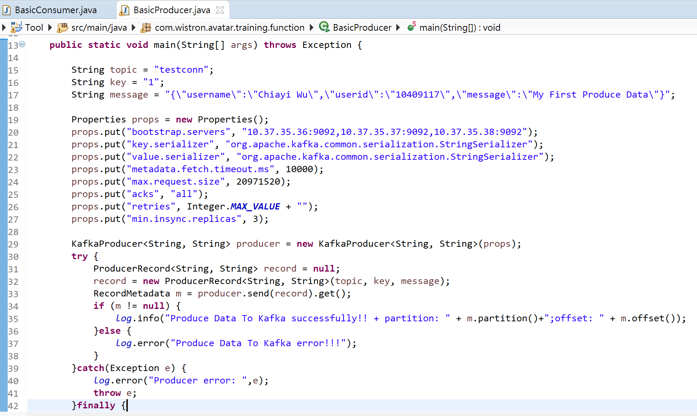
Producer
Java code

Slide 16
Consumer
The Consumer API allows an application to subscribe to one or more topics and process the stream of records produced to them.

Slide 17
Consumer Properties
Consumer Group
group.id: unique consumer group id
auto.offset.reset: What to do when there is no initial offset in Kafka or if the current offset does not exist any more on the server
earliest: automatically reset the offset to the earliest offset.
latest: automatically reset the offset to the latest offset. AVATAR Java Consumer use this config.

Slide 18
Consumer Properties
auto.offset.reset:
earliest: automatically reset the offset to the earliest offset.
latest: automatically reset the offset to the latest offset. AVATAR Java Consumer use this config.
Topic 1
Partition 0
0 | 1 | 2 | 3 | 4 | 5 | 6 | 7 | … | …
Consumer 1 start
→earliest: offset 0~4…
→latest: offset 5~7……

Slide 19
Consumer
max.partition.fetch.bytes: The maximum amount of data per-partition the server will return.
20MB/offset in DEV/QAS/PRD
enable.auto.commit: If true the consumer's offset will be periodically committed in the background.
true in DEV/QAS/PRD, also set offset by topic + partition + consumer groupid in Redis

Slide 20
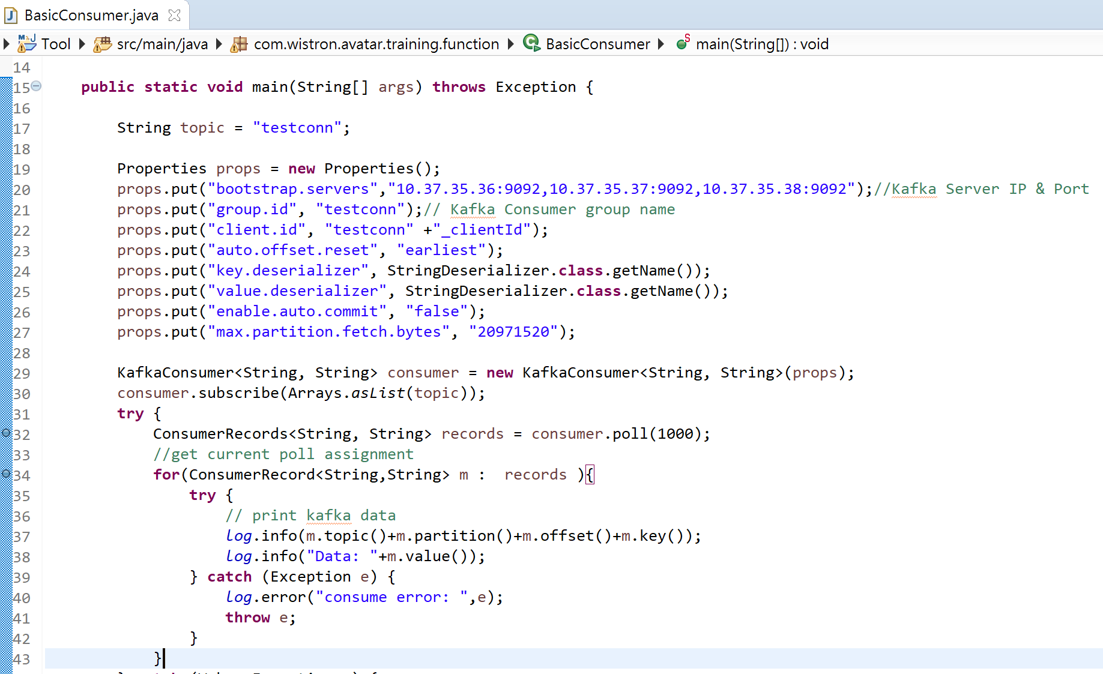
Consumer
Java Code

Slide 21
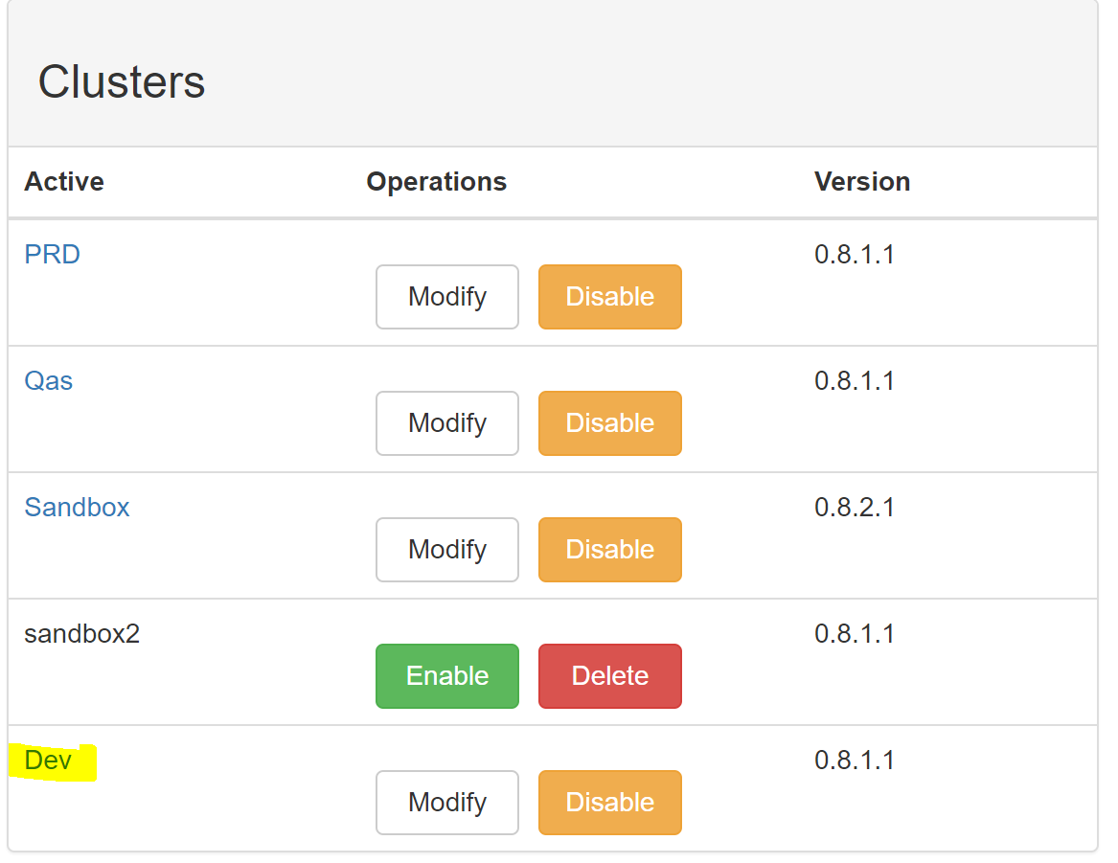
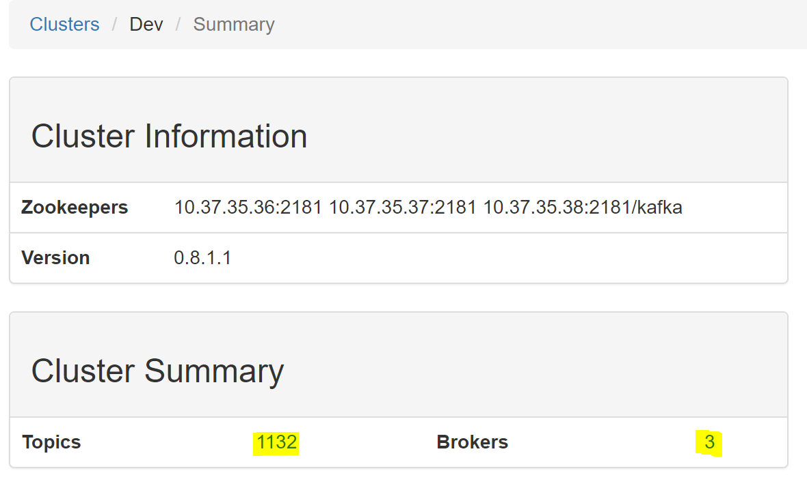
Tool - Kafka manager
http://10.37.35.36:9000/

Slide 22
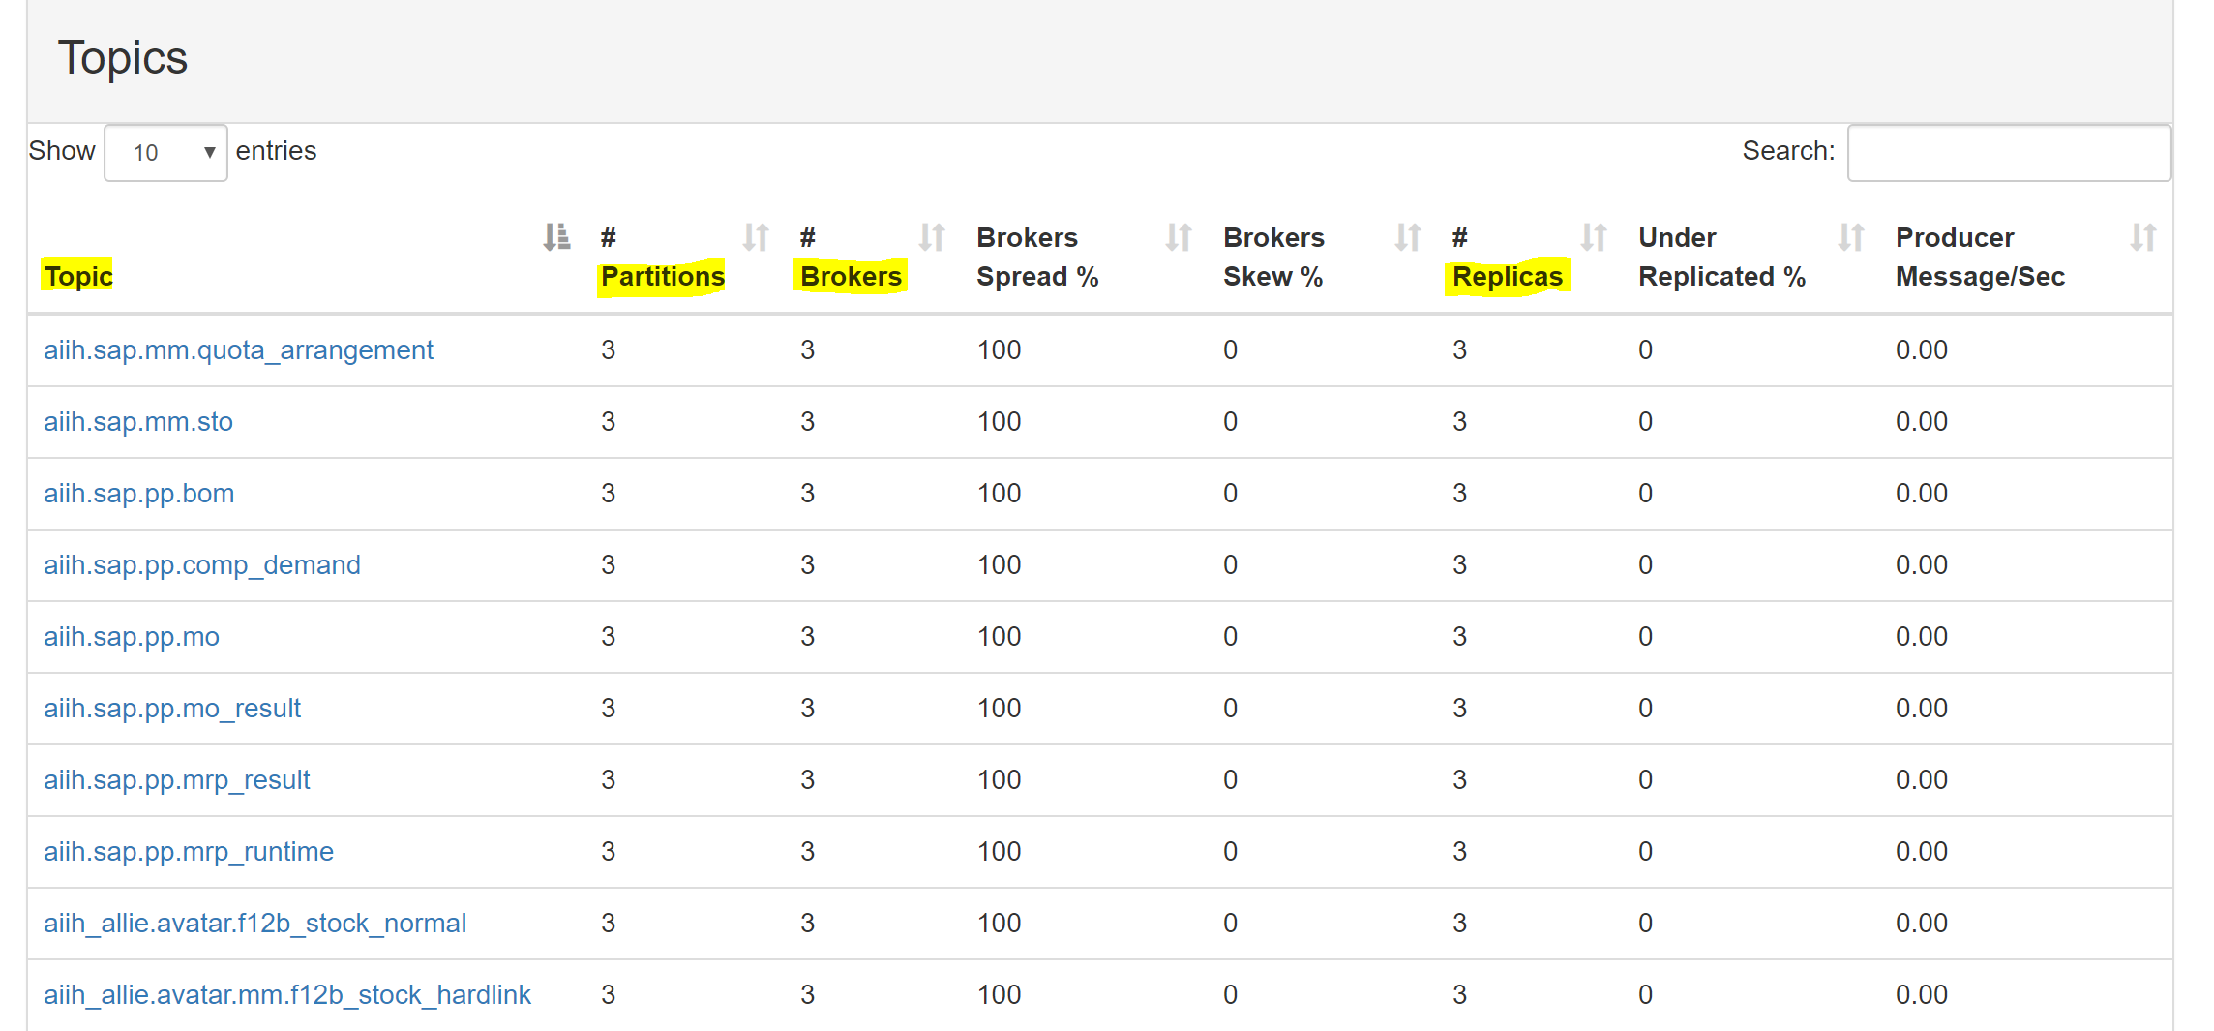
Tool - Kafka manager

Slide 23
Homework
Produce data to Dev Kafka & Consume data from Dev Kafka
Kafka Topic: User Name Ex: ChiayiWu
Kafka Key: User ID Ex:10409117
Kafka Value:
Ex: {"username": " Chiayi Wu"," "userid":"10409117","message":"My First Produce Data"}

Slide 24
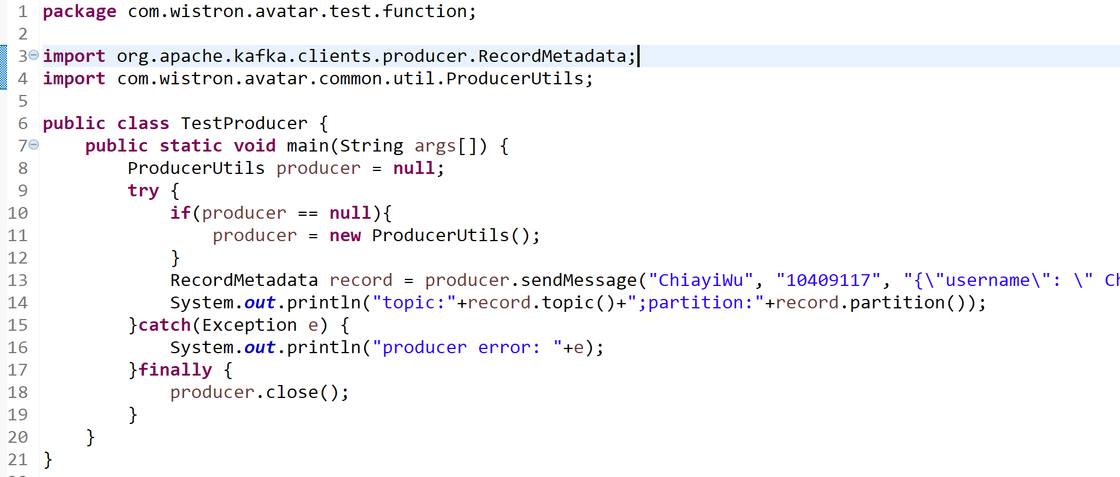
Sample Producer

Slide 25
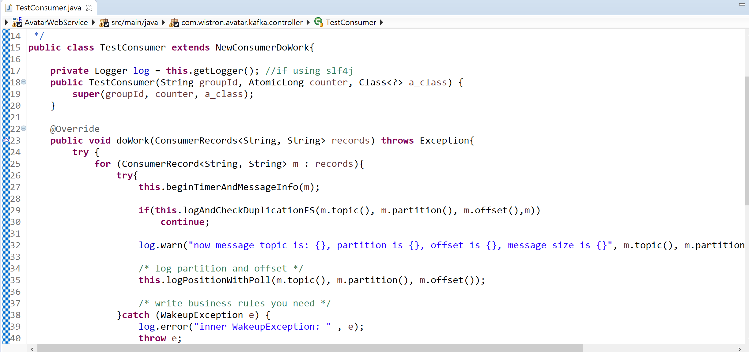
Sample Consumer
Project: AvatarWebService
Path: com.wistron.avatar.kafka.controller.TestConsumer

Slide 26
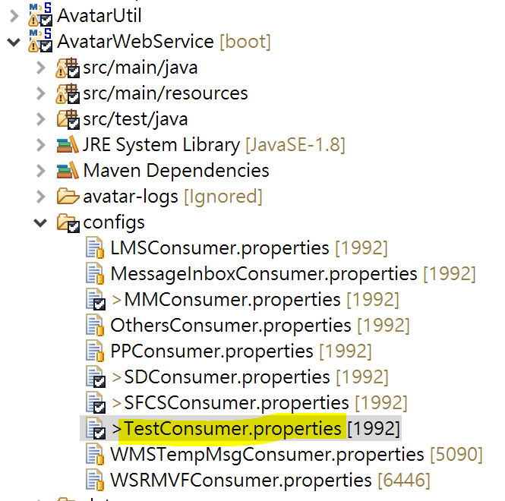
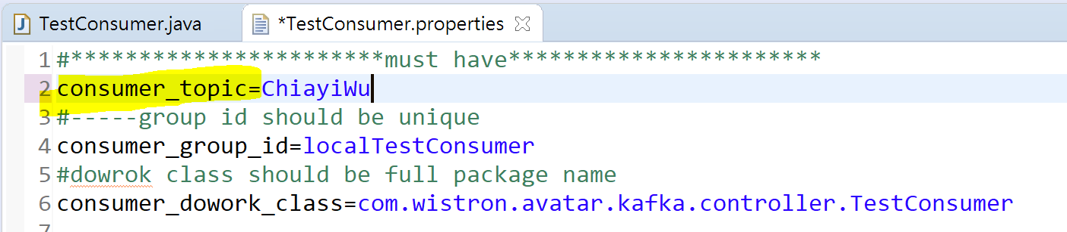
How to test consumer
Edit test topic name in TestConsumer.properties

Slide 27
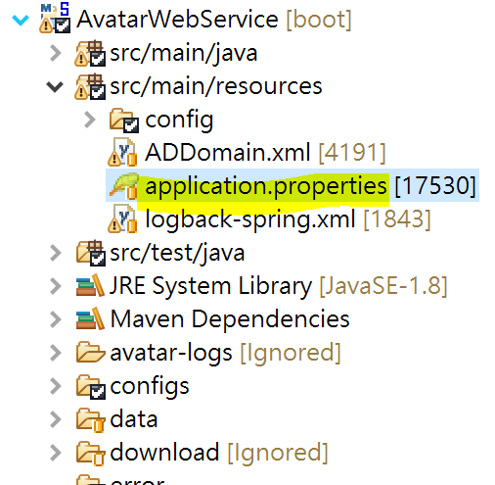
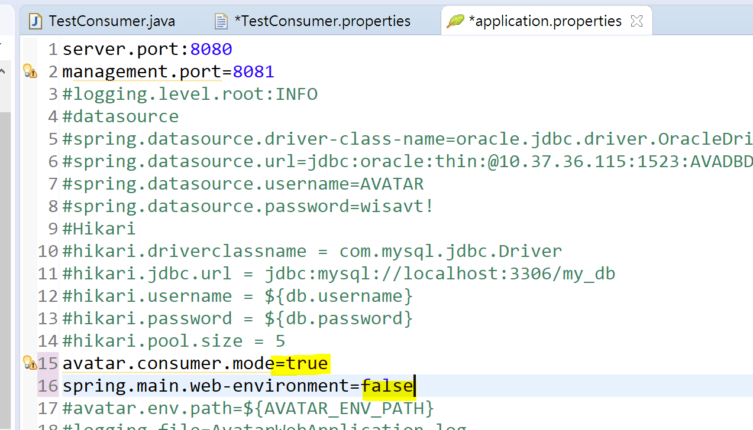
How to test consumer
Edit consumer mode in application.properties

Slide 28
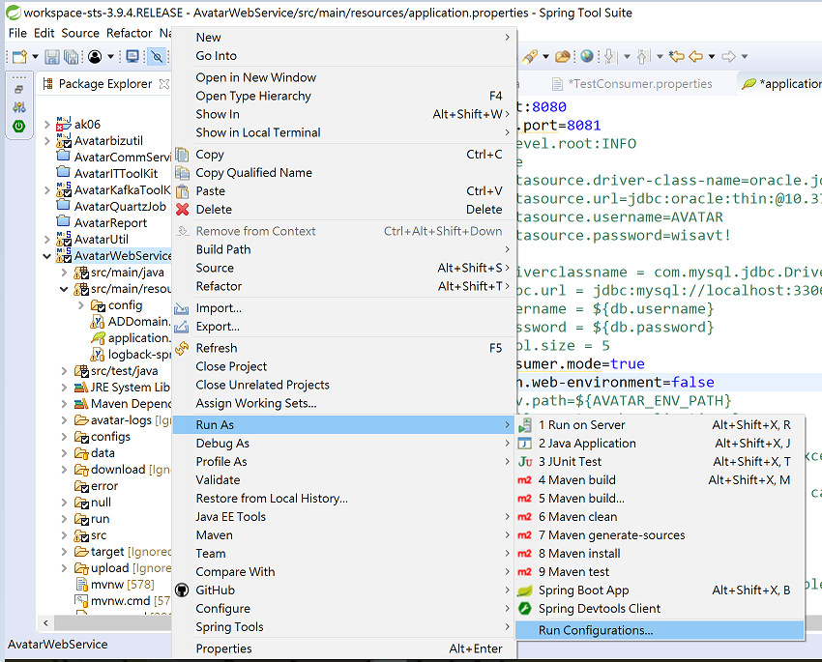
How to test consumer
AvatarWebService➔
Run As➔
Run Configuration

Slide 29
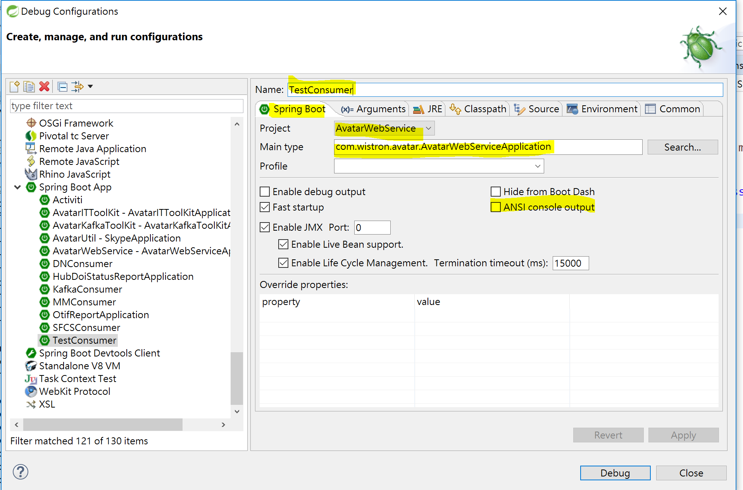
How to test consumer

Slide 30
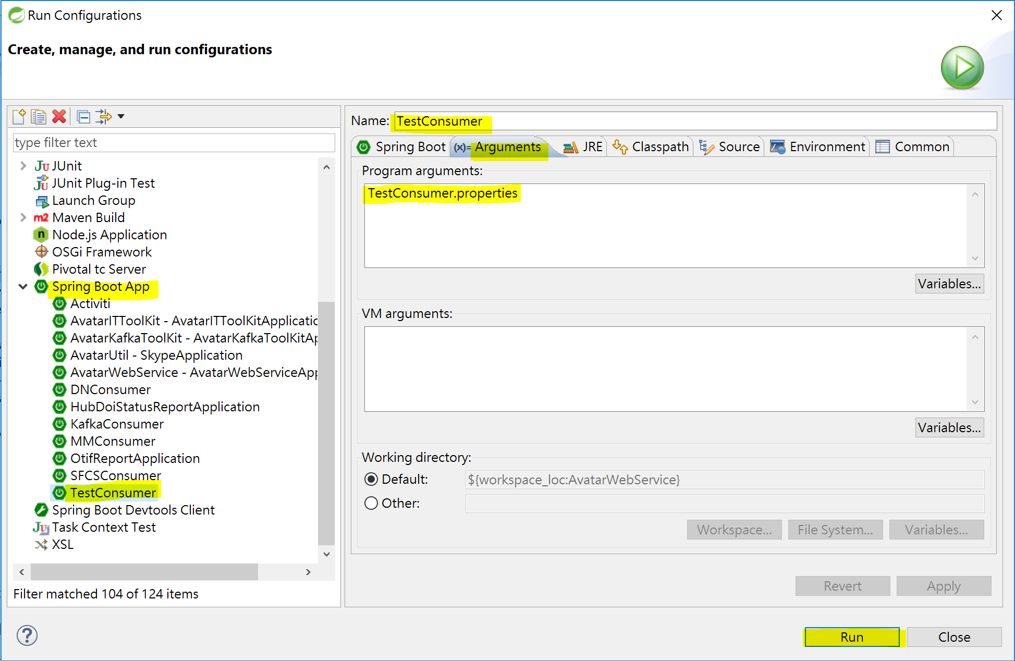
How to test consumer

Slide 31
Q & A

